Slide 1
Harbor Deep Dive
Open source trusted cloud native registry
Henry Zhang, Chief Architect, VMware R&D China
Steven Zou, Staff Engineer, VMware R&D China
Nov. 2018

Slide 2

HARBOR
An open source trusted cloud native registry project
goharbor.io
Initiated by VMware China, maintained by whole community
Integrated into enterprise products: VIC and PKS
Apache 2.0 license
GitHub Repo: https://github.com/goharbor/harbor/

Slide 3
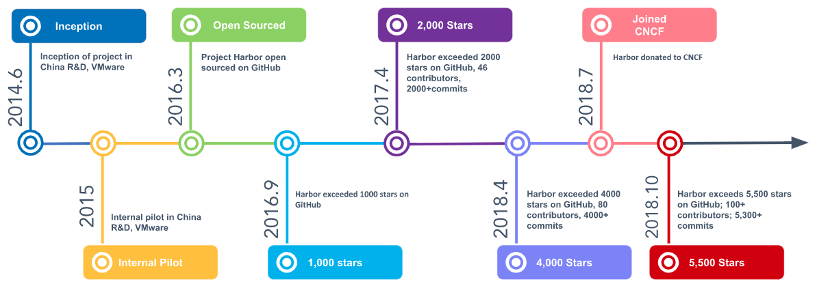





Harbor Project History
More integrations in future

Slide 4
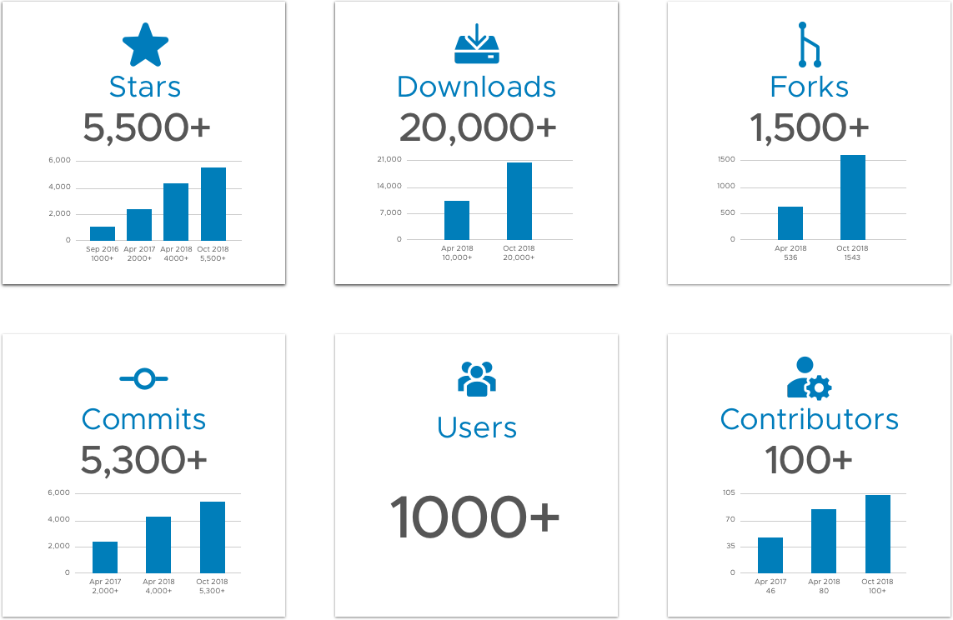
Harbor Community

Slide 5






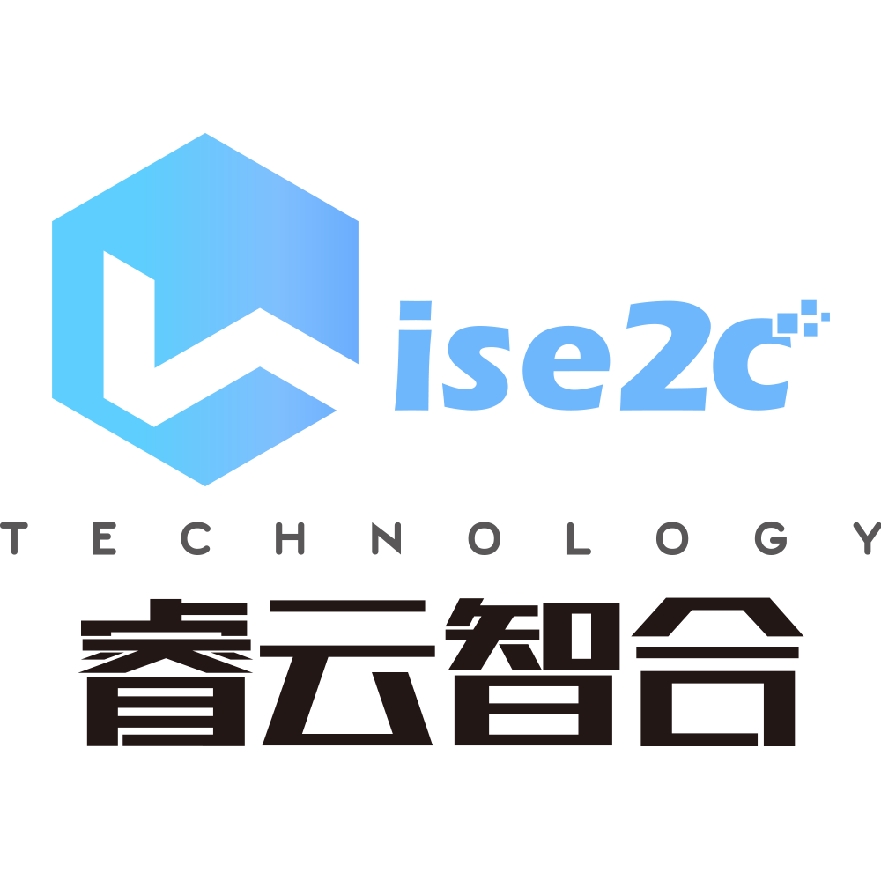














Harbor Users and Partners (selected)
x
x

Slide 6





Main Features
Web Portal
Restful API
Replication
Based on open source Clarity
Image operation full capabilities
Batch operations
Complete API for integration
Swagger API doc
Multiple filters support
Schedule, immediate and manual trigger
Access Control
Audit Log
Distribution Policy
RBAC
AD/LDAP integration
Operations recorded for audit
Based on content trust
Based on vulnerability
Based on RBAC

Slide 7





Main Features（Cont.）
Vulnerability Scanning
Content Trust
Label
Kinds of scanning policies
Elaborate scanning report
Digital signature
Label in project and system scopes
Mark labels to image and chart
Helm Chart Support
Multi Deployments
High Availability
Helm Chart repository
Same mechanism and user experiences with image management
Docker Compose
BOSH/Pivotal Tile
Helm Chart
HA support

Slide 8


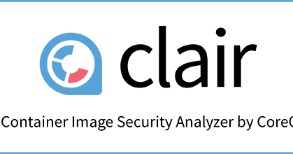




Harbor Architecture
Consumers
3rd party components
Users (GUI/API)
Container Schedulers/Runtimes
Harbor components
Persistence components
Supporting services
API Routing
LDAP/Active Directory
Core Service (API/Auth/GUI)
Trusted Content
Docker
Harbor Packaging
Kubernetes
Image Registry
Job Service
Admin Service
Vulnerability Scanning
Cloud Foundry
Key/Value Storage
SQL Database
Local or Remote Storage (block, file, object)

Slide 9
Deep dive Harbor through panel discussion!

Slide 10
Q1: What other features harbor should provide?

Slide 11
Q2: How does the Harbor architecture evolve?

Slide 12
Q3: How to converge management of image and chart?

Slide 13
Q4: Is it reasonable to involve day0 operation in Harbor?

Slide 14
HARBOR
Website：https://github.com/goharbor/harbor
Twitter: @Project_harbor
Slack: #harbor/#harbor-dev (register via slack.cncf.io)
Email group：（Refer README on GitHub for the subscription way ）
harbor-users@googlegroups.com
harbor-dev@googlegroups.com
WeChat group: Contact speakers

Slide 15
Thank You

